Slide 1
TROPICAL CYCLONE INTENSITY ESTIMATION USING DEEP LEARNING
BY:
ARTHI V(1817107)
MIRNALINI S(1817131)
MONISHA K(1817132)
NISHANTHINI B(1817136)
RANI PANDEY(1817140)
GUIDE:
Dr.K.KUMAR
(AP-CSE)

Slide 2
OBJECTIVE:
TC intensity prediction models can help planners, decision-makers, and inhabitants in coastal regions for emergency preparedness.
These models can also help the government departments to develop appropriate strategies for disaster management and mitigation measures.
In order to develop a model for predicting the Tropical Cyclone(TC) activity, it is essential to know the contributing factors that affect Tropical Cyclone(TC) intensity at basin- and regional-scale.
Our aim is to calculate the Wind Intensity by giving the Tropical Cyclone images as input.
With the calculated wind intensity value of the Gaja Cyclone , the Cyclone is categorized into six types which is used to take the preventive measures.

Slide 3
PROPOSED ARCHITECTURE:
The architecture model that we proposed are,
ResNet-34
VGG-19
Inception ResNet v2

Slide 4
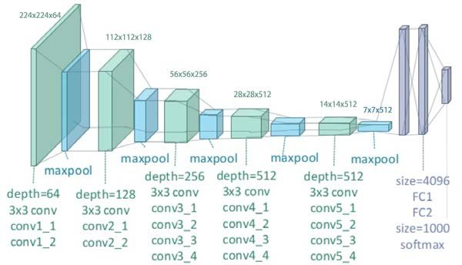
VGG – 19 ARCHITECTURE:

Slide 5
MODEL SUMMARY:
Layer(type) | Output shape
Input_9 (InputLayer) | (None,224,224,3)
block1_conv1(Conv2D) | (None,224,224,64)
block1_conv2(Conv2D) | (None,224,224,64)
block1_pool(MaxPooling2D) | (None,112,112,64)
block2_conv1(Conv2D) | (None,112,112,128)
block2_conv2(Conv2D) | (None,112,112,128)
block2_pool(MaxPooling2D) | (None,56,56,128)
block3_conv1(Conv2D) | (None,56,56,256)
block3_conv2(Conv2D) | (None,56,56,256)
block3_conv3(Conv2D) | (None,56,56,256)
block3_conv4(Conv2D) | (None,56,56,256)
block3_pool(MaxPooling2D) | (None,28,28,256)

Slide 6
Layer(type) | Output Shape
block4_conv1(Conv2D) | (None,28,28,512)
block4_conv2(Conv2D) | (None,28,28,512)
block4_conv3(Conv2D) | (None,28,28,512)
block4_conv4(Conv2D) | (None,28,28,512)
block4_pool(MaxPooling2D) | (None,14,14,512)
block5_conv1(Conv2D) | (None,14,14,512)
block5_conv2(Conv2D) | (None,14,14,512)
block5_conv3(Conv2D) | (None,14,14,512)
block5_conv4(Conv2D) | (None,14,14,512)
block5_pool(MaxPooling2D) | (None,7,7,512)
flatten | (None,25088)
Dense | (None,256)
Dense | (None,1)

Slide 7
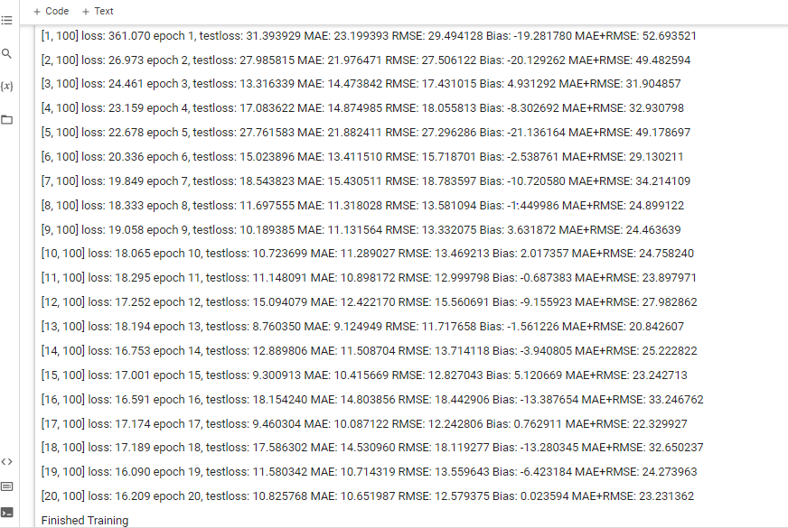
TRAINING:
Training VGG-19 model with batch size 16

Slide 8
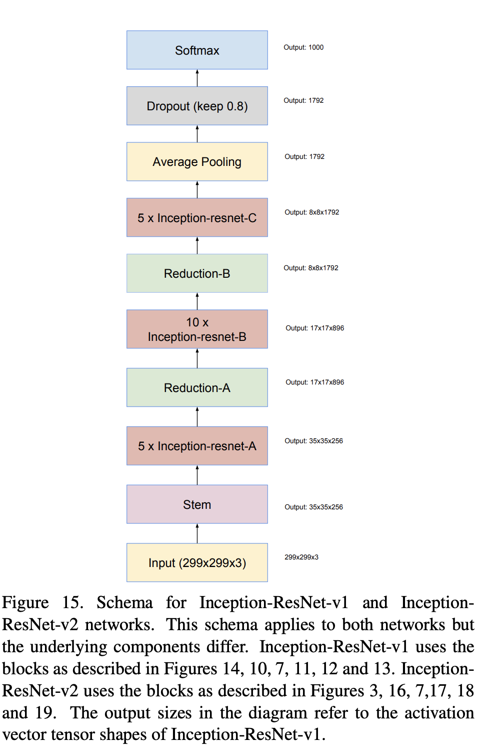
INCEPTION-RESNET-V2 ARCHITECTURE:

Slide 9
MODEL SUMMARY:
Input | 299x299x3
Stem | 35x35x256
5 x Inception-resnet-A | 35x35x256
Reduction-A | 17x17x896
10 x Inception-resnet-B | 17x17x896
Reduction-B | 8x8x1792
5 x Inception-resnet-C | 8x8x1792
Average pooling | 1792
Dropout | 1792
Softmax | 1

Slide 10
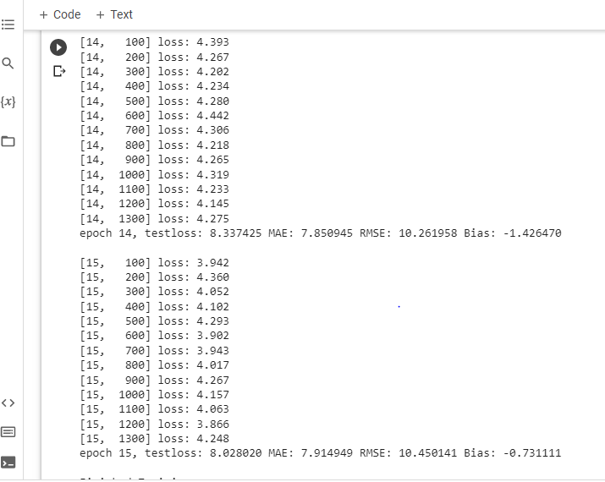
TRAINING:
Training Inception-ResNet-V2 model with batch size 16

Slide 11
TESTING:
Testing is the process where the performance of a fully trained model is evaluated on testing dataset.
To predict the model, testing dataset images are preprocessed and then fed to the model. Testloss was calculated for each model.
Total Testloss is 16.09,7.734 and 8.028 for VGG-19,ResNet-34 and Inception-ResNet-V2 model respectively.
Wind intensity is estimated for testset data for each model.
Using the wind intensity, Category of cyclone is classified.

Slide 12
The criteria below have been formulated by Indian Meteorological Department, which classifies the low pressure systems on basis of capacity to damage, which is adopted by WMO.
Type of Disturbance | Wind Speed in Km/h
Depression | Less than 51
Deep Depression | 52-62
Cyclonic Storm | 63-87
Severe Cyclonic Storm | 88-110
Very Severe Cyclonic Storm | 111-130
Extremely Severe Cyclonic Storm(Super Typhoon) | More than 130

Slide 13
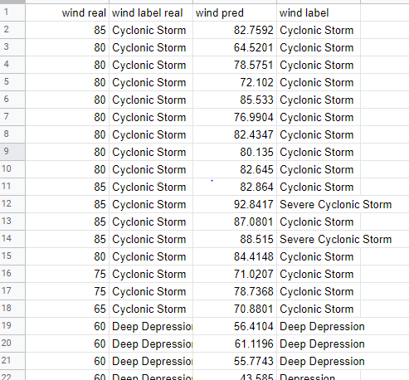
Sample estimation of wind intensity and its category prediction by Inception-ResNet-V2 model from testing dataset

Slide 14
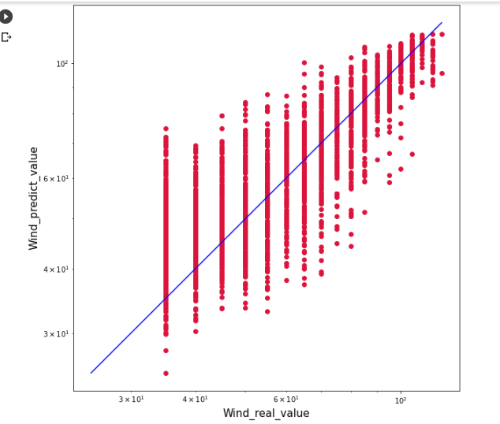
Scatter graph for Wind prediction value against Wind real value

Slide 15
COMPARATIVE ANALYSIS
 | VGG-19 | ResNet-34 | Inception-ResNet-V2
Model Architecture | 16 convolutional layer 3 fully connected layer | 33 convolutional layer 1 fully connected layer | 164 deep layers
Advantages | Works depth on accuracy | Allows skipping connections | Extract features from input data at varying scales with varying filter size

Slide 16
 | VGG-19 | ResNet-34 | Inception-ResNet-V2
Disadvantages | Vanishing gradient problem and loss sums is unpredictable | Complexity of architecture | Requirement of more data for high recognization performance
Result | RMSE – 12.58 (for 20 epoch) | RMSE – 11.05 (for 20 epoch) | RMSE – 10.45 (for 15 epoch)
Inference | Training time is low Deeper the model, need to focused on feature extraction. | Higher than VGG-19 Works better than VGG-19 | Moderate training time Works deeper and wider on images and extracts more features. Best among the other 2 proposed model

Slide 17
INTRODucing NEW:
Dataset – Gaja Cyclone
Description:
Gaja cyclone was formed on 10 November 2018. We Collected Gaja cyclone IR image from various sources.
 | Maximum wind intensity | Category
Actual | 140 Km/h | Very Severe Cyclonic Storm
Predicted | 128 Km/h | Very Severe Cyclonic Storm

Slide 18
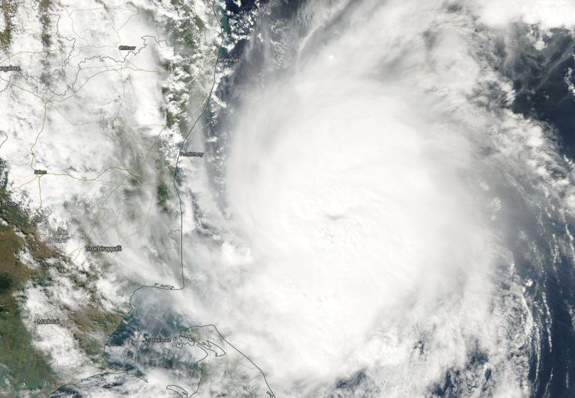
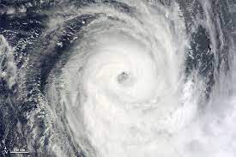
GAJA CYCLONE IMAGES
Dated on – 15112018
Wind Intensity – 102 Km/h
Dated on - 17112018
Wind Intensity – 130 Km/h

Slide 19
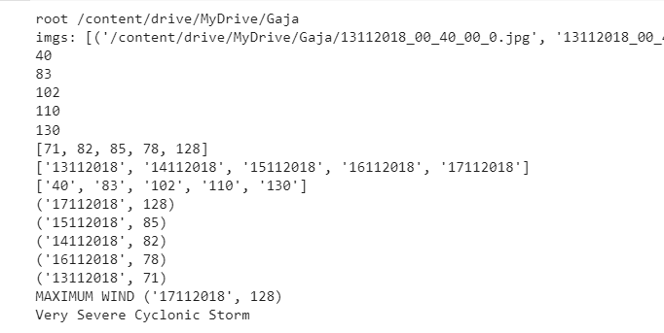
Result for Gaja cyclone dataset

Slide 20
REFERENCE:
[1] https://www.mdpi.com/2072-4292/12/1/108/htm
[2] https://journals.ametsoc.org/view/journals/wefo/34/2/waf-d-18-0136_1.xml
[3] https://www.readkong.com/page/tropical-cyclone-intensity-estimations-over-the-indian-5067256
[4] https://journals.ametsoc.org/view/journals/mwre/147/6/mwr-d-18-0391.1.xml
[5] https://link.springer.com/article/10.1007/s42452-019-1134-8#Tab1

Slide 21
Thank You!

